Slide 1
AVL Tree A Balanced Binary Search Tree
Revised based on textbook author’s notes and Professor Booth’s notes.

Slide 2
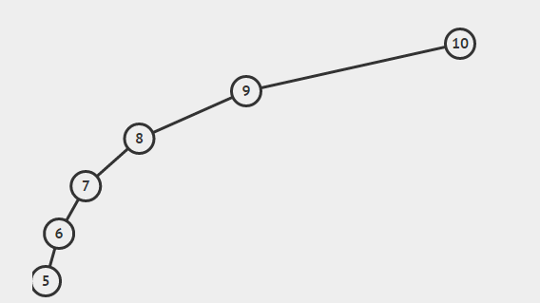
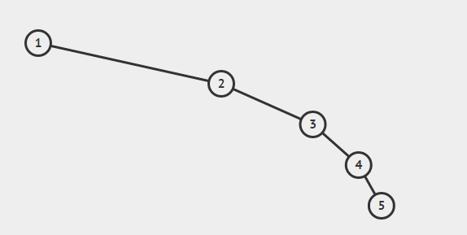
How bad!?!?
Balance – the height of left and right subtree approximately equal
Our standard binary trees can be bad!
What if we made a search tree from an ordered list?

Slide 3
AVL Tree Background
Developed by G.M. Adelson-Velskii and E.M. Landis in 1962
Goal: try to keep the tree balanced during insertion and removal.
Ensures height never exceeds 1.44 log n
Worst case of tree height O(log n)
An AVL tree is a binary search tree that the height of two children differ by no more than one.

Slide 4
These are AVL trees, ‘=‘ denotes children are of equal height, ‘<‘ or ‘>’ differ by one.
=

Slide 5
The tree on the right is not an AVL tree, after the node with 28 is inserted. The balance signs along the branch where 28 is inserted have to be revised. And the tree has to be re-balanced if to maintain it as an AVL tree.

Slide 6
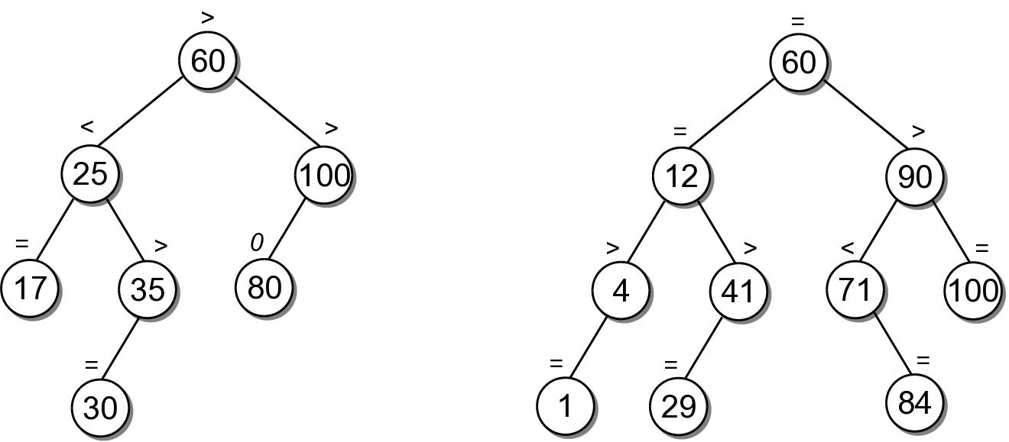
Balance Factor
So what states of balance exist?
Left-high ‘>’
Equal-high ‘=‘
Right-high ‘<‘
=

Slide 7
How do we maintain balance?
Well that is the million dollar question!
We will use rotations!
All rotations happen at a fixed point
This fixed point is the pivot node
Not really the instance of the node, but the location of the node!

Slide 8
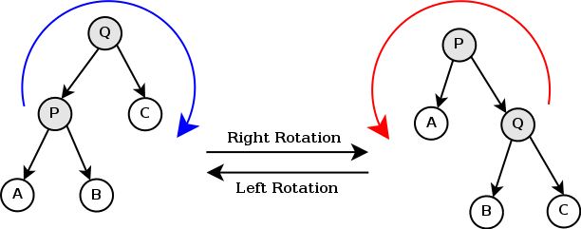
Rotations
Right Rotation
Pivot Q
Q becomes the parent of B
P becomes the parent of Q
Left Rotation
Pivot P
P becomes the parent of B
Q becomes the parent of P

Slide 9
Rotations

Slide 10
Insertion
Now we have our weapon (rotations) and we will use it
Step 1. Find a place to add the element as a leaf node
Same as BST
Step 2. Rebalance
Four Cases to consider

Slide 11
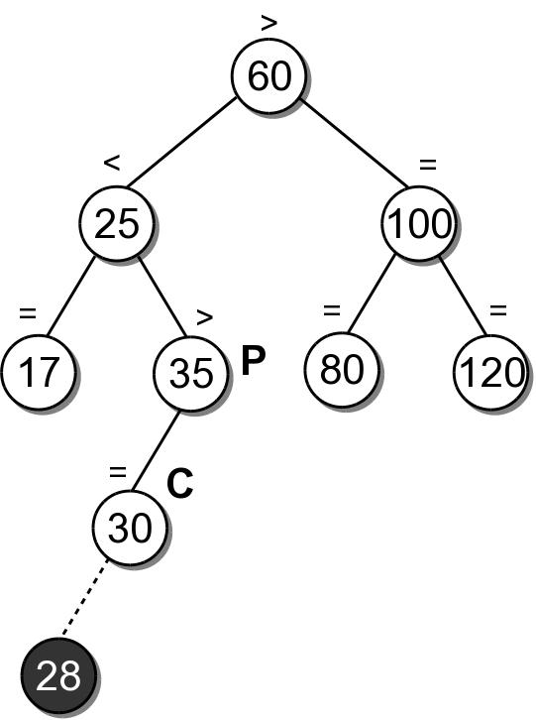
Case 1.
Add to the left side of a subtree that is already left-high
Insert 28.
Walk down to find a place to insert 28.
Walk back up the path and found a node with left-high and we added to the left! Now very left-high! We need to fix this!
Fix?

Slide 12
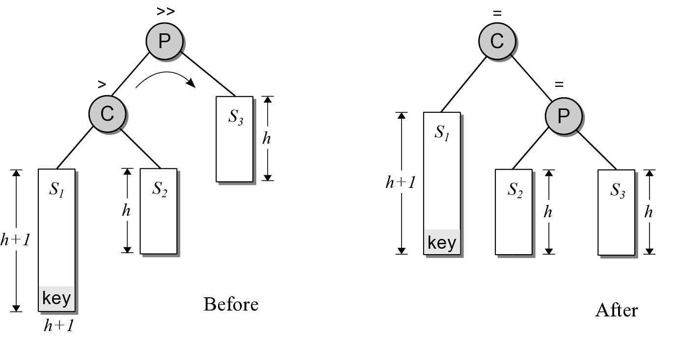
Case 1
How do we fix the balance?
At the node with left-high (P) on the return path,….
What do we know about the subtree P?
We know the left side subtree height is now 2 nodes higher than the height of the right subtree
We know if we could rotate one node for the left into the right the subtrees will be equal
Therefore, rotate right!

Slide 13
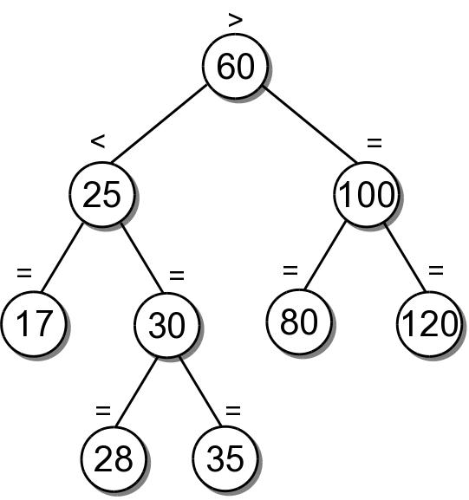
Easy Example (Case 1)

Slide 14
More Complex Example (Case 1)
50 – Left-heavy

Slide 15
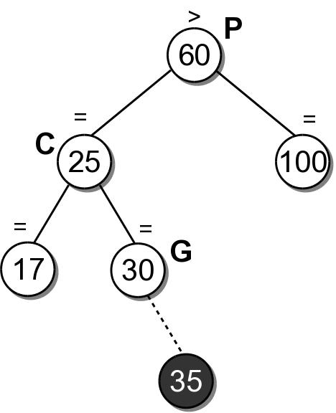
Case 2
Add node as a right or left leaf node of a path where you are right of your grandparent, C, (equal-high) and left of your great grandparent, P, (left-high).
Insert 35.
Walk down to find a place to insert 35.
Walk back up the path to 30, make G right-high ‘<‘
Walk back up the path to 25, make C right-high ‘<‘
Walk back up the path to 60, Oh no! Was already left-high and now left is even more taller! Fix this!
Fix?

Slide 16
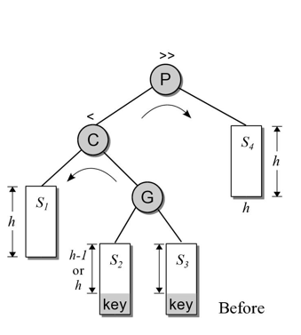
Case 2
How do we fix this imbalance?
At node with left-high (P)
Would a simple rotation help?
Left rotation around P – would make the left branch of P more taller (more ‘left-high’)!
A simple right rotation around P – would make C the new root, P the right child of C, G the left child of P, s1 the left child of C. The tree is not balanced as the right-height(C)= height(P)+1 = height(G)+h+1 >> left-height(C) == h
What if we do a left rotation on the left child of P (node C) first, followed by a right rotation of P?
Result
1. Left rotation on P.left (C in this case)
2. Right rotation on P
2
1

Slide 17
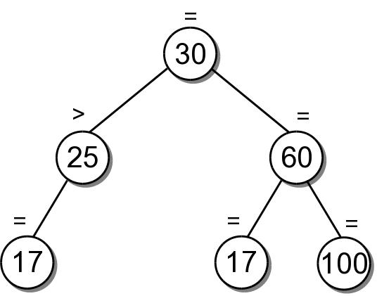
Example (Case 2)
35

Slide 18
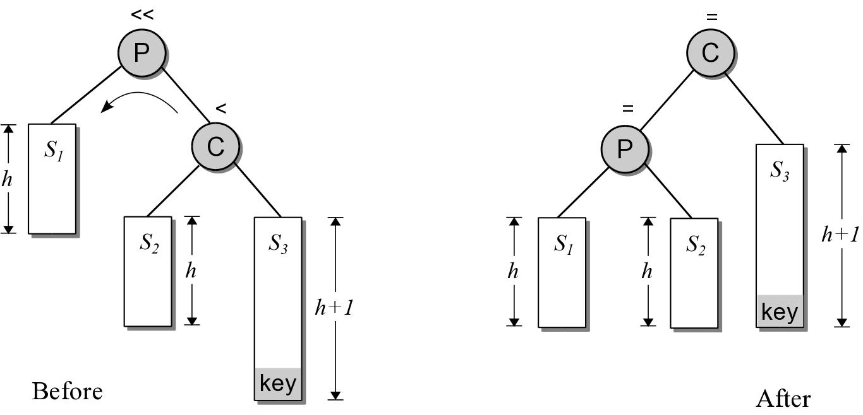
Case 3
Mirror image of Case 1
P is right-high
New key is inserted in right subtree of C
Shown below is ‘before’ and ‘after’ balancing, but after inseration!

Slide 19
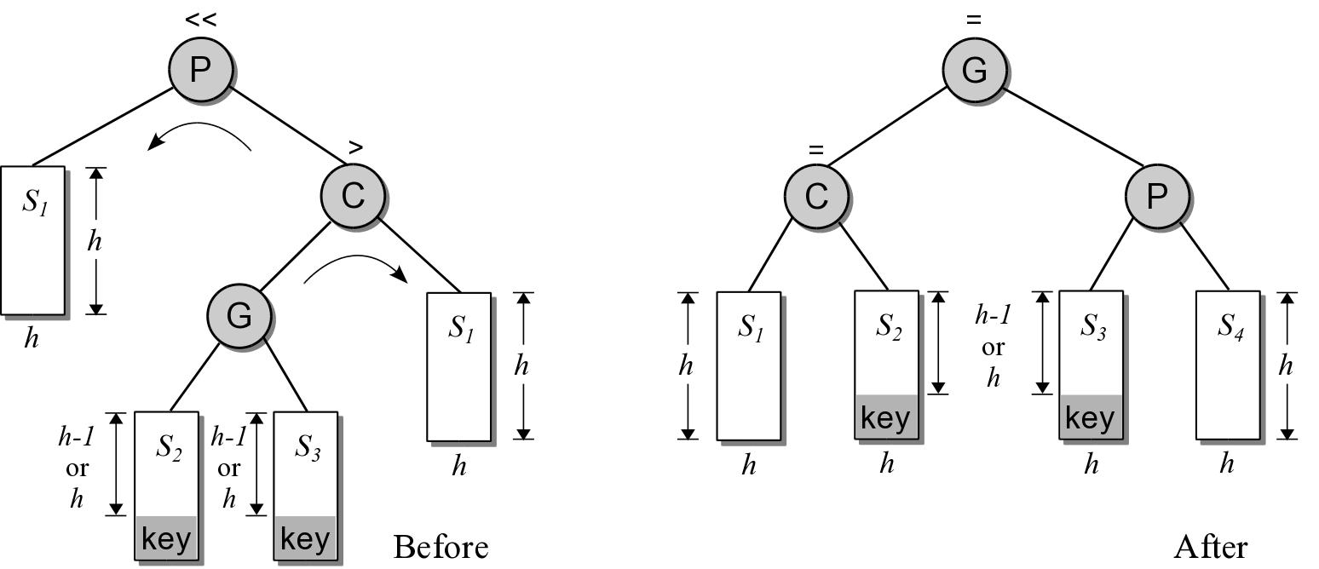
Case 4
Mirror image of Case 2
P is right-high
G is the left child of C instead of the right
Right child of C is S4
S4

Slide 20
Building AVL Tree [60,25,35,100,17,80]

Slide 21
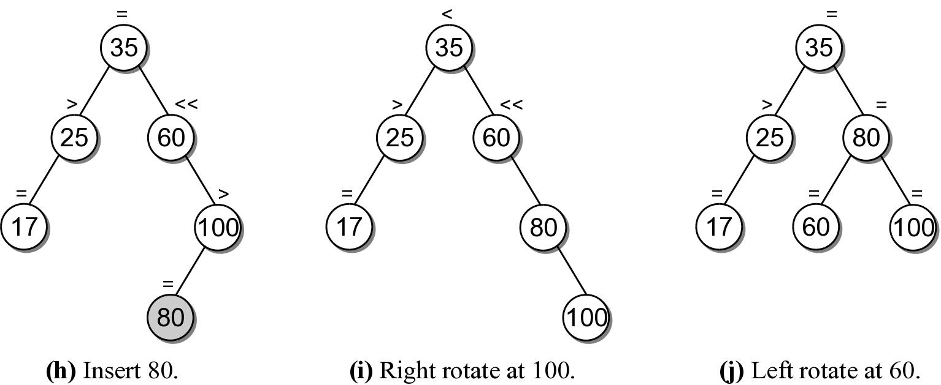
Building AVL Tree [60,25,35,100,17,80]

Slide 22
AVL Removal
First remove as we do in BST
Rebalance

