Slide 1
Hash Maps Implementation and Applications
Revised based on textbook author’s notes.

Slide 2
Table Size
How big should a hash table be?
If we know the max number of keys.
create it big enough to hold all of the keys.
In most instances, we don't know the number of keys.
Most probing techniques work best when the table size is a prime number.

Slide 3
Rehashing
We can start with a small table and expand it as needed.
Similar to the approach used with the array.
load factor – the ratio between the number of keys and the size of the table.
A hash table should be expanded before the load factor reaches 80%.

Slide 4
Rehashing Example
After creating a larger array for the table, we can not simply copy the original keys to the new table.
We must rebuild or rehash the entire table.
h(765) => 0 h(579) => 1
h(431) => 6 h(226) => 5
h(96) => 11 h(903) => 2
h(142) => 6 => 7 h(388) => 14

Slide 5
Expansion Size
Size of the expansion depends on the application.
Good rule of thumb is to at least double its size.
Two common approaches:
double the size of the table, then search for the first larger prime number.
double the size of the table and add one to ensure M is odd.

Slide 6
Efficiency Analysis
Depends on:
the hash function
size of the table
type of collision resolution probe
Once an empty slot is located, adding or deleting a key can be done in O(1) time.
The time required to perform the search is the main contributor to the overall time of all ops.

Slide 7
Efficiency Analysis
Best case: O(1)
The key maps directly to the correct entry.
There are no collisions.
Worst case: O(m)
Assume there are n keys stored in a table of size m.
The probe has to visit every entry in the table.

Slide 8
Efficiency Analysis
While hashing appears to be no better than a basic linear search or binary search in worst case, hashing is very efficient in the average case with load factor < 0.8. (Table shows the data for M == 13.)
Remember linear search O(n), binary search O(log n) and log 13 is about 3.7.
Load Factor | 0.25 | 0.5 | 0.67 | 0.8 | 0.99
Successful search:
Linear probe | 1.17 | 1.50 | 2.02 | 3.00 | 50.50
Quadratic probe | 1.66 | 2.00 | 2.39 | 2.90 | 6.71
Unsuccessful search:
Linear probe | 1.39 | 2.50 | 5.09 | 13.00 | 5000.50
Quadratic probe | 1.33 | 2.00 | 3.03 | 5.00 | 100.00

Slide 9
Hash Functions
The efficiency of hashing depends in large part on the selection of a good hash function.
A “perfect” function will map every key to a different table entry.
This is seldom achieved except in special cases.
A “good” hash function distributes the keys evenly across the range of table entries.

Slide 10
Function Guidelines
Important guidelines to consider in designing a hash function.
Computation should be simple.
Resulting index can not be random.
Every part of a multi-part key should contribute.
Table size should be a prime number.

Slide 11
Common Hash Functions
Division – simplest for integer values.
Truncation – some columns in the key are ignored.
Example: assume keys composed of 7 digits.
Use the 1st, 3rd, 6th digits to form an index (M = 1000).
h(key) = key % M

Slide 12
Common Hash Functions
Folding – key is split into multiple parts then combined into a single value.
Given the key value 4873152, split it into three smaller values (48, 73, 152).
Add the values together and use with division.

Slide 13
Hashing Strings
Strings can also be stored in a hash table.
Convert to an integer value that can be used with the division or truncation methods.
Simplest approach: sum the ASCII values of individual characters.
Short strings will not hash to larger table entries.
Better approach: use a polynomial.

Slide 14
The HashMap ADT
Hash tables are commonly used to implement a map or dictionary.
Same as the Map ADT.
Keys must be hashable.
Python's dictionary is implemented using a hash table.

Slide 15
HashMap Implementation
Hash table:
Initial size: M = 7
Must expand as needed.
Load factor: 2/3
Expansion size: 2M + 1
Entries:
class _MapEntry :
def __init__( self, key, value ):
self.key = key
self.value = value

Slide 16
HashMap Implementation
Use double hashing:
Hash function:
Probe function:
hash() is Python's built-in hash() function.
Takes a built-in type as the key and returns an int value that can be used with division method.
h(key) = |hash(key)| % M
hp(key) = 1 + |hash(key)| % (M - 2)

Slide 17
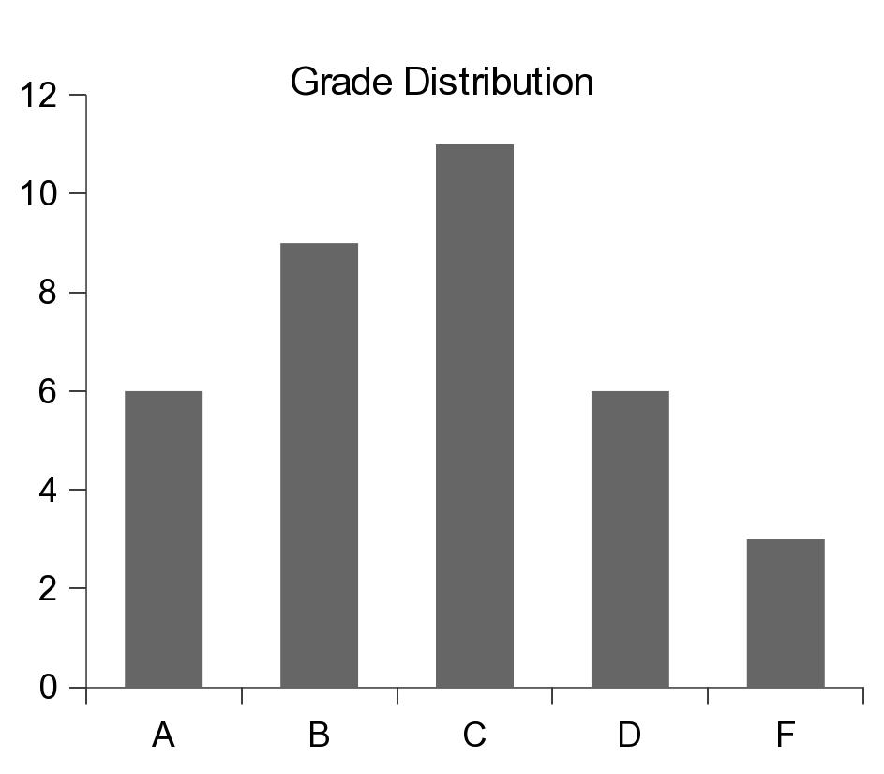
Application: Histograms
Graphical chart of tabulated frequencies.
Very common in statistics.
Used to show the distribution of data

Slide 18
The Histogram ADT
A histogram is a container that can be used to collect and store discrete frequency counts across multiple categories.
The category objects must be comparable.
Histogram( catSeq ) getCount( category ) incCount( category ) totalCount() iterator()

Slide 19
Building a Histogram
We can use the ADT to show a grade distribution.
Input: text file containing int grades
Output
77 89 53 95 68 86 91 89 60 70 80 77 73 73 93 85 83
67 75 71 94 64 79 97 59 69 61 80 73 70 82 86 70 45 100
Grade Distribution
|
A +******
|
B +*********
|
C +***********
|
D +******
|
F +***
|
+----+----+----+----+----+----+----+----
0 5 10 15 20 25 30 35

Slide 20
Histogram: Example
buildhist.py
from maphist import Histogram
def main():
# Create a Histogram instance for computing the frequencies.
gradeHist = Histogram( "ABCDF" )
# Open the text file containing the grades.
gradeFile = open('cs204grades.txt', "r")
# Extract the grades and increment the appropriate counter.
for line in gradeFile :
grade = int(line)
gradeHist.incCount( letterGrade(grade) )
# Print the histogram chart.
printChart( gradeHist )

Slide 21
Histogram: Example
buildhist.py
# Determines the letter grade for the given numeric value.
def letterGrade( grade ):
if grade >= 90 :
return 'A'
elif grade >= 80 :
return 'B'
elif grade >= 70 :
return 'C'
elif grade >= 60 :
return 'D'
else :
return 'F'

Slide 22
Histogram: Example
buildhist.py
def printChart( gradeHist ):
print( " Grade Distribution" )
# Print the body of the chart.
letterGrades = ( 'A', 'B', 'C', 'D', 'F' )
for letter in letterGrades :
print( " |" )
print( letter + " +", end = "" )
freq = gradeHist.getCount( letter )
print( '*' * freq )
# Print the x-axis.
print( " |" )
print( " +----+----+----+----+----+----+----+----" )
print( " 0 5 10 15 20 25 30 35" )
# Calls the main routine.
main()

Slide 23
The Color Histogram
Used to tabulate the frequency counts of individual colors within a digital image.
Example that deals with millions of distinct categories, none of which are known up front.
Used in image processing and digital photography.
The Histogram ADT would not be efficient for this application.

Slide 24
Color Histogram ADT
A color histogram is a container that can be used to collect and store frequency counts for multiple discrete RGB colors.
RGB values are discrete in the range [0 ... 255].
ColorHistogram() getCount( red, green, blue ) incCount( red, green, blue ) totalCount() iterator()

Slide 25
Color Histogram: Organization
What data structure should be used?
3-D array of size 256 x 256 x 256:
Very fast with direct access.
Far too costly in terms of memory.
Vector or linked list:
Better in terms of memory.
Inefficient when working with millions of colors.

Slide 26
Color Histogram: Organization
What about hashing?
Closed hashing:
Inefficient due to the many rehashes that would be required.
Separate chaining:
Requires a good hash function and appropriately sized hash table.

Slide 27
Color Histogram: Organization
What about a custom structure that combines:
advantage of direct access of a 3-D array
limited memory use and fast searches of hashing.
Structure:
2-D array of linked lists.
array elements correspond to red and green.
linked lists represent the chains for all colors with the same red and green components.

Slide 28
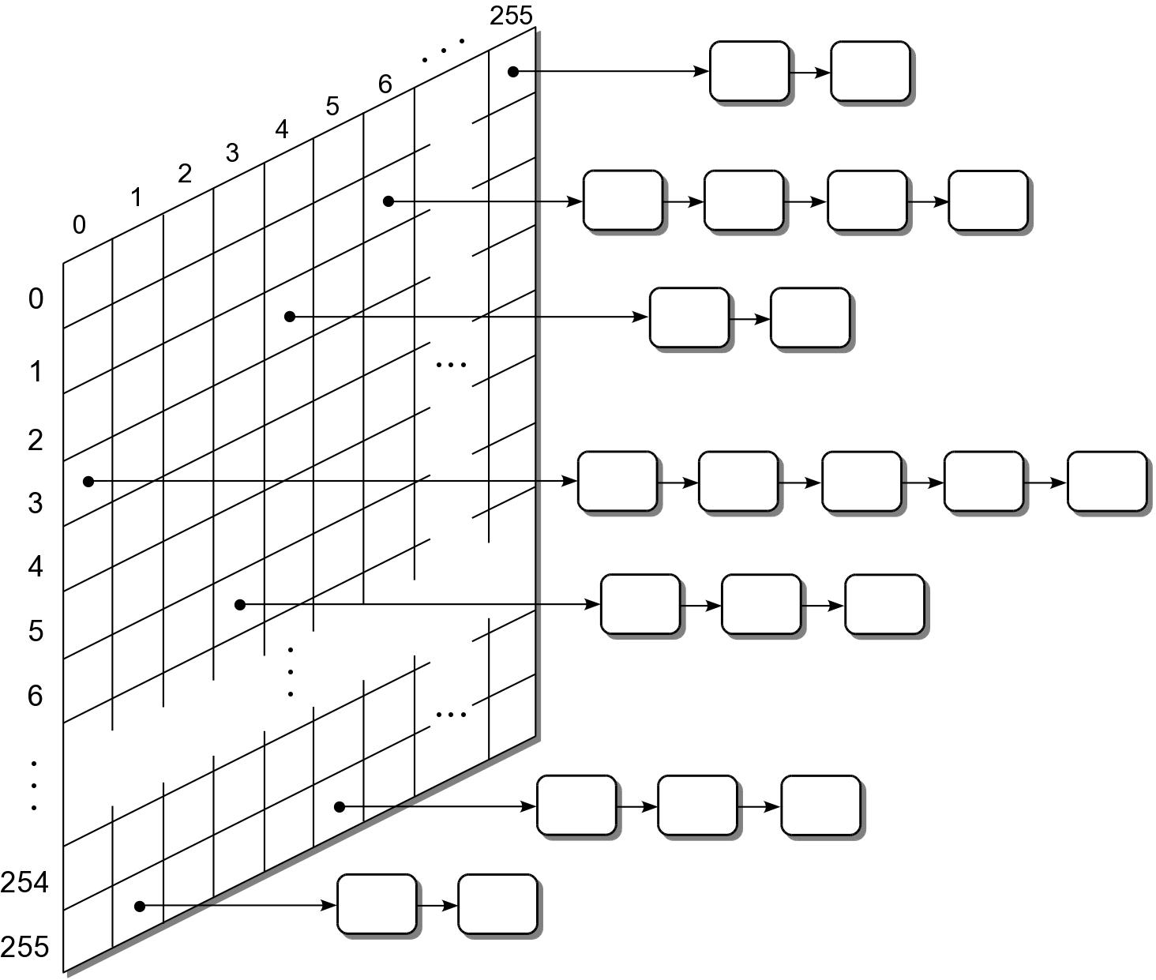
Color Histogram: Organization

Slide 29
Color Histogram: Traversals
After a color histogram is constructed, it's common to perform a traversal over the unique colors.
Could traverse over every element of the 2-D array.
Look for non empty chains and traverse the list.
This can be time consuming.
In practice, many of the elements will not contain any colors.
How can we improve the time required to perform a traversal.

Slide 30
Color Histogram: Traversals
Modify the structure:
add a second link to each color node to create multi-linked nodes.
when a new color is added to the histogram, add it to a second linked list (colorList).
A traversal is performed by iterating over the nodes in the colorList.

Slide 31
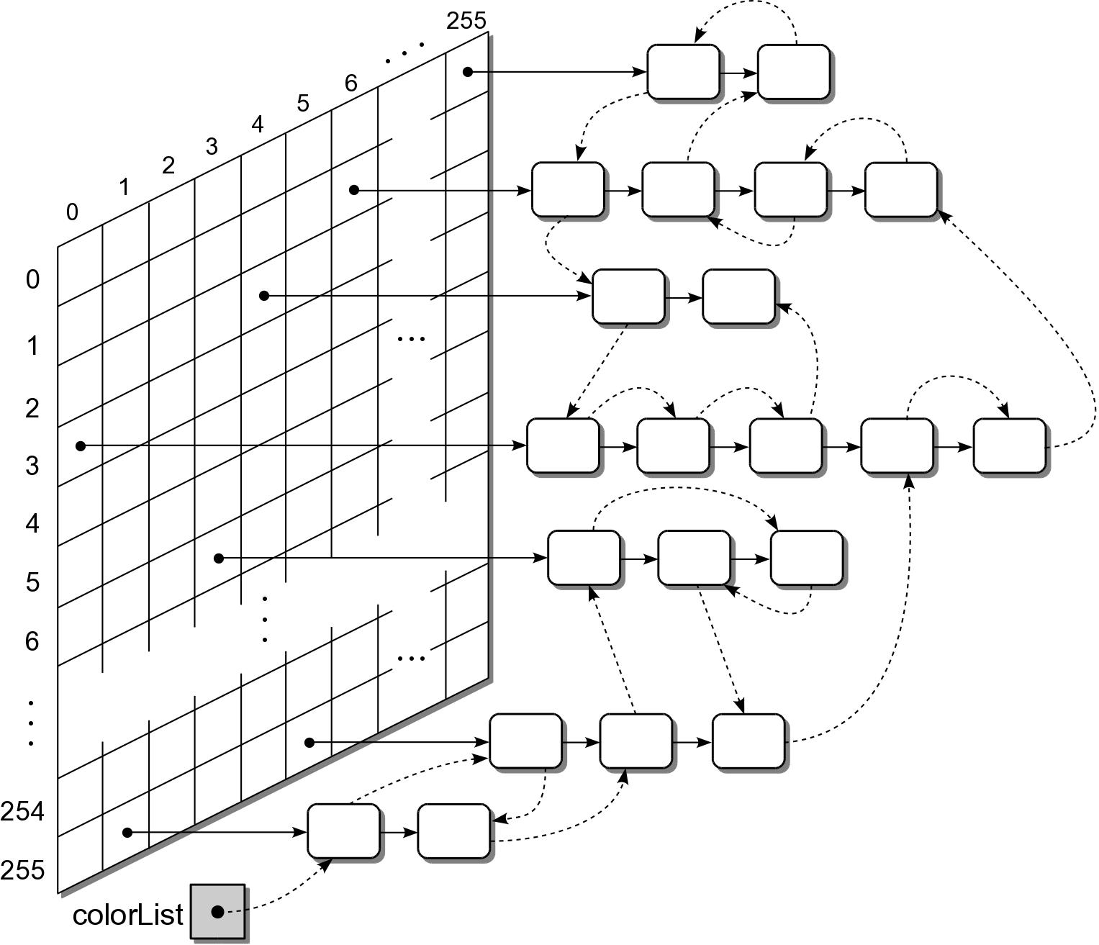
Color Histogram: Traversals

