Slide 1
Mergesort
Revised based on textbook author’s notes.

Slide 2
Review
sorting – the process of arranging a collection of items such that each item and its successor satisfy a prescribed relationship.
sort key – values on which items are ordered.
items arranged in ascending or descending order.

Slide 3
Sorting Algorithms
Can be divided into two categories:
comparison sorts
items are arranged by performing pairwise logical comparisons between two sort keys.
distribution sorts
distributes the sort keys into intermediate groups based on individual key values.

Slide 4
Merge Sort
Uses a divide and conquer strategy to sort the keys stored in a sequence.
Keys are recursively divided into smaller and smaller subsequences.
Subsequences are merged back together.

Slide 5
Merge Sort – Divide
Starts by splitting the original sequence in the middle to create two subsequences of approximately equal size.

Slide 6
Merge Sort – Divide
The two subsequences are then split in the middle.

Slide 7
Merge Sort – Divide
The subdivision continues until there is a single item in the sequence.

Slide 8
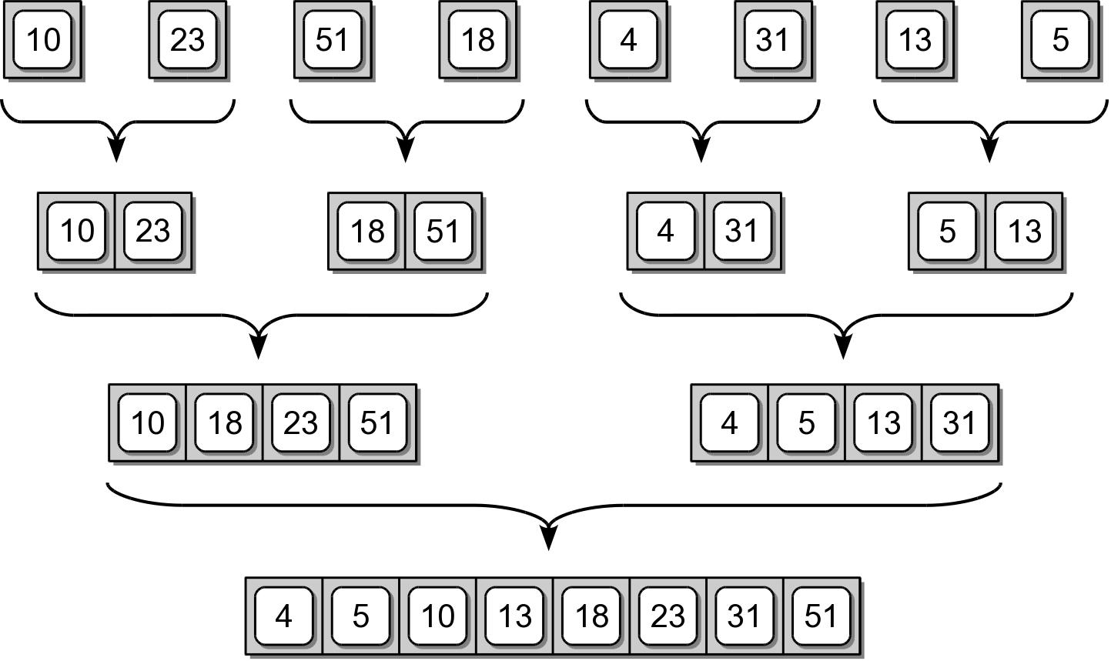
Merge Sort – Conquer
After the sequences are split, they are merge back together, two at a time to create sorted sequences.

Slide 9
Merge Sort Code #1
A simple implementation for sorting a Python list.
def pythonMergeSort( theList ):
# Check the base case.
if len(theList) <= 1 :
return theList
else :
# Compute the midpoint.
mid = len(theList) // 2
# Split the list and perform the recursive step.
leftHalf = pythonMergeSort( theList[ :mid ] )
rightHalf = pythonMergeSort( theList[ mid: ] )
#Merge the two ordered sublists.
newList = mergeOrderedLists( leftHalf, rightHalf )
return newList

Slide 10
Merge Sort – Improved Version
The previous version:
only works with Python lists.
the splitting creates new physical lists.
uses the splice operation which is time consuming.

Slide 11
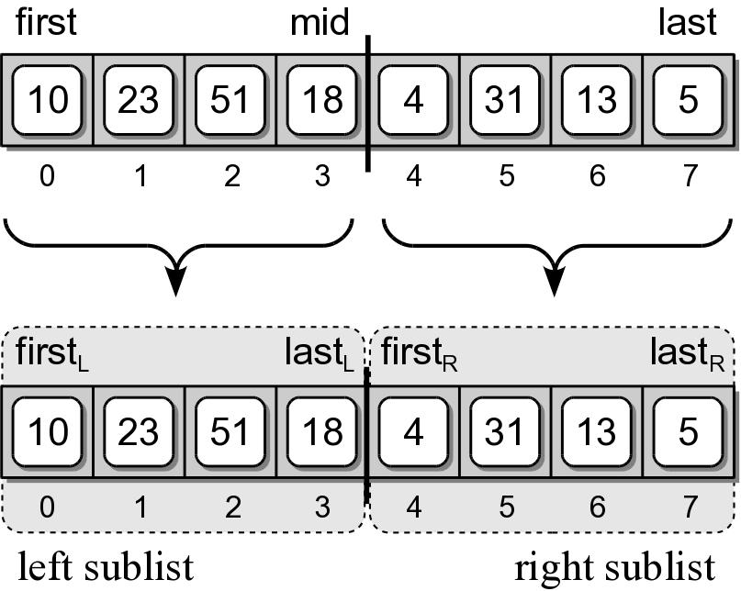
Merge Sort – Improved Version
We can improve the implementation:
using virtual subsequences.
that works with any sequence.

Slide 12
Merge Sort Code #2
An improved version of the merge sort.
def recMergeSort( theSeq, first, last, tmpArray ):
# Check the base case.
if first == last :
return
else :
# Compute the mid point.
mid = (first + last) // 2
# Split the sequence and perform the recursive step.
recMergeSort( theSeq, first, mid, tmpArray )
recMergeSort( theSeq, mid+1, last, tmpArray )
# Merge the two ordered subsequences.
mergeSeq( theSeq, first, mid+1, last, tmpArray )

Slide 13
Merging Sorted Sequences
def mergeSeq( theSeq, left, right, end, tmpArray ):
a = left
b = right
m = 0
while a < right and b <= end :
if theSeq[a] < theSeq[b] :
tmpArray[m] = theSeq[a]
a += 1
else :
tmpArray[m] = theSeq[b]
b += 1
m += 1
:
:

Slide 14
Merging Sorted Sequences
:
:
while a < right : # in parallel with first while
tmpArray[m] = theSeq[a]
a += 1
m += 1
while b <= end : # in parallel with the two whiles
tmpArray[m] = theSeq[b]
b += 1
m += 1
for i in range( end – left + 1 ) :
theSeq[i+left] = tmpArray[i]

Slide 15
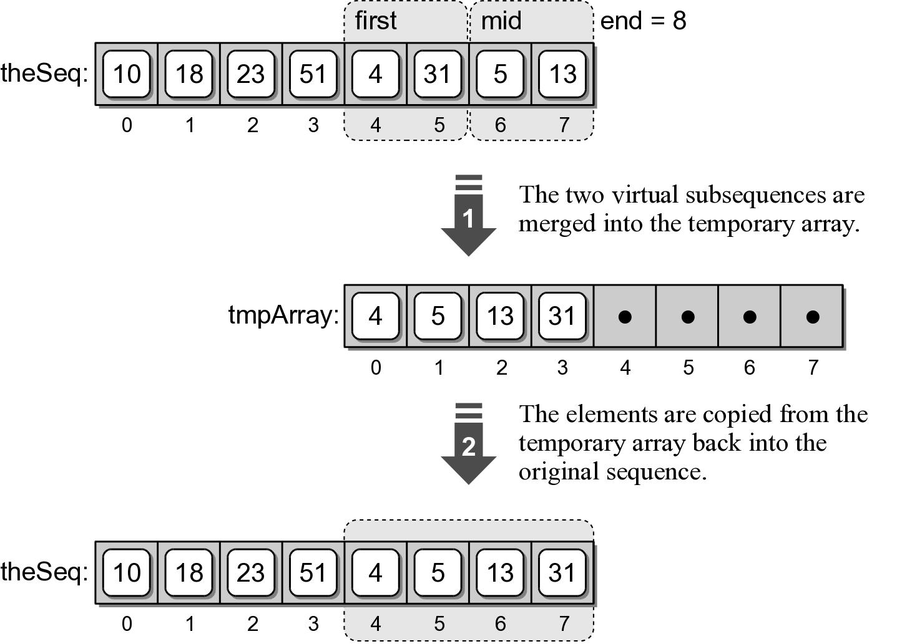
Merge Sort – Temporary Array
A temporary array is used to merge two virtual subsequences.

Slide 16
Wrapper Functions
A function that provides a simpler and cleaner interface for another function.
Provides little or no additional functionality.
Commonly used with recursive functions that require additional arguments.
def mergeSort( theSeq ):
n = len( theSeq )
tmpArray = Array( n )
recMergeSort( theSeq, 0, n-1, tmpArray )

Slide 17
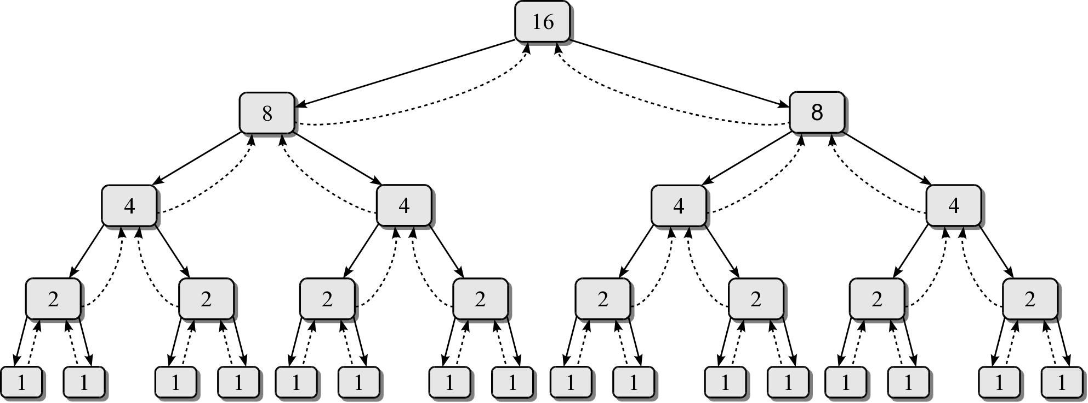
Merge Sort – Efficiency
We need to determine the number of invocations and the time required by each function.

Slide 18
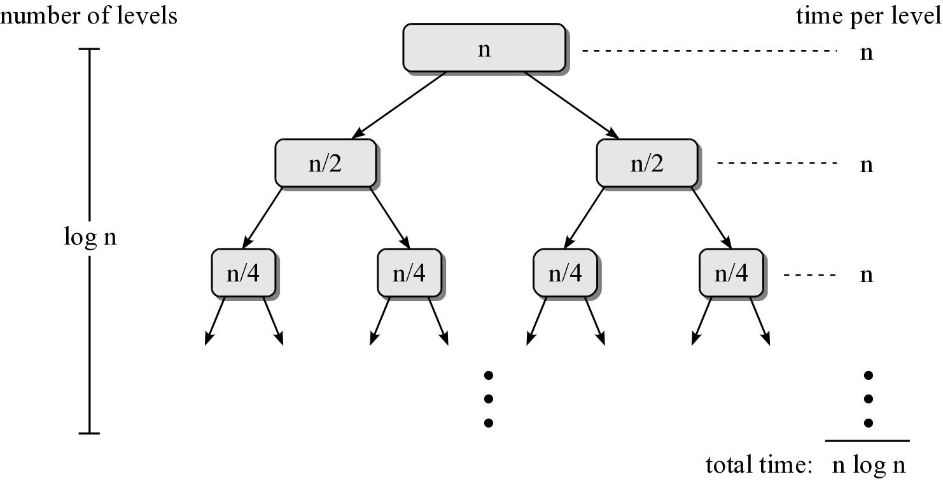
Merge Sort – Efficiency
Consider a sequence of n items.

