Slide 1
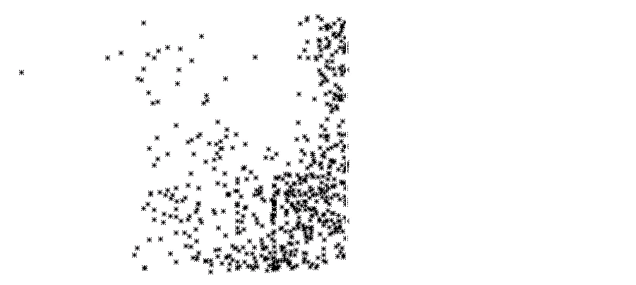
Invariant manifolds and barriers blocking swimming microbes in vortex flows
Cameron Lodi*, Tom Solomon*, Simon Berman# and Kevin Mitchell#
*Bucknell University and #UC-Merced
Key idea: Common theory of active mixing that applies to both propagating reaction fronts and self-propelled tracers in fluid flows.
Supported by NSF Grants DMR-1806355, CMMI-1825379 and S-STEM Program #1742124
Notes:
Exploring how theory that accurately predicts front propagation can also explain bacteria.
So we’ll discuss how the theory works with reaction fronts before diving into the summer’s work…which is swimming bacteria.

Slide 2
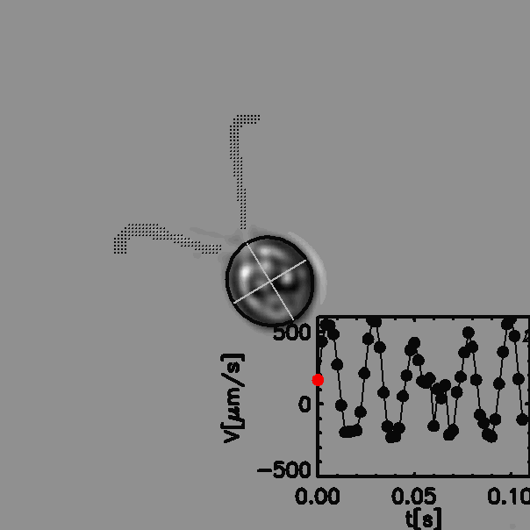
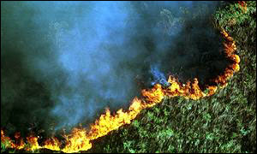

How is a swimming microbe like a forest fire?
?
=
Chlamydomonas reinhardtii
(green algae)
(From Gollub research group)
Forest fire in Brazil, image from BBC news, 9/2/1999
Notes:
… BUT the really cool thing about this work is that the same theory describes a wide
range of active mixing problems, not just swimming microbes. In fact, the theory that we will discuss for self-propelled tracers in a flow is almost identical to one that describes the motion of reaction fronts in the same flow.
The issue of how a reaction front propagates in a fluid flow is a problem that our group and our collaborators at UC-Merced have studied extensively over the past decade …

Slide 3
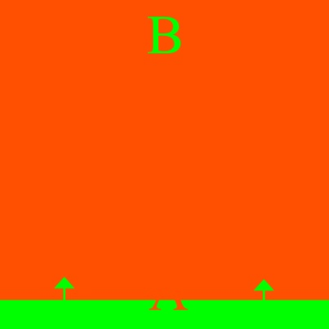
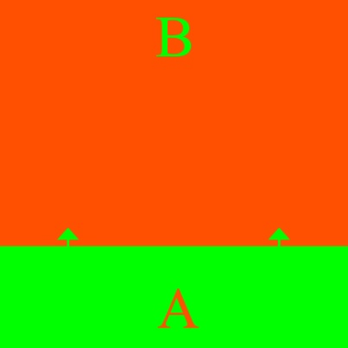
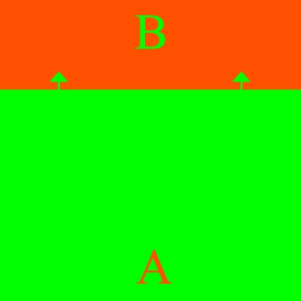

Front propagation
  Examples
  Combustion reactions
  Bio systems: plankton blooms, spreading diseases, predator-prey systems, embryonic processes?
  Solidification
Forest fire in Brazil, image from BBC news, 9/2/1999
Notes:
Front propagation, most generally, is the growth of a species A, at the expense of another species B.
My favorite example – pour gasoline on floor, light a match …
Our question: how is the behavior of the fronts affected by fluid mixing? In the analogy with burning gasoline on the floor, this is the question of what happens if we are stirring the gasoline while the flame is moving across.
Examples of front propagation include combustible systems, where you have a flame propagating across fuel.
Epidemiological systems, where disease spreads from the infected to the uninfected.
Solidification, where a solid grows from a liquid.

Slide 4
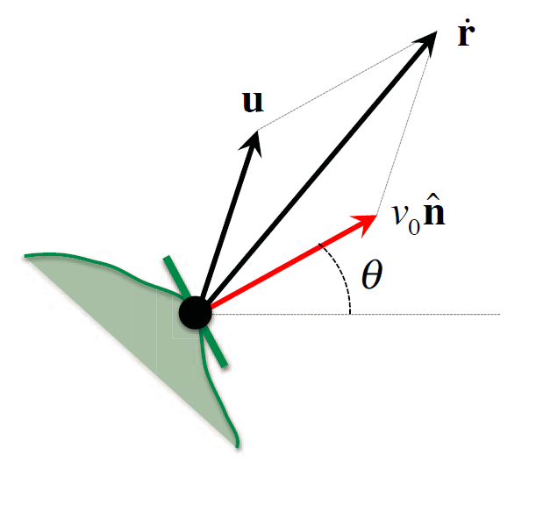
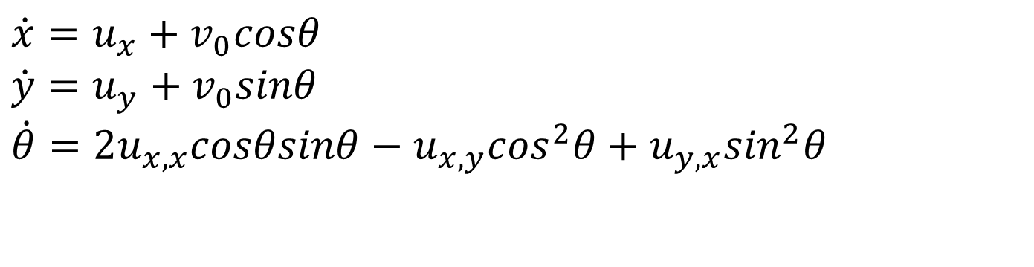
Theory for reaction fronts in fluid flows → Advection Reaction Diffusion
Approach: model the evolution of the front
→ 3 variables (x,y,θ) that describe a piece of the front
$$\dot{x}=u_{x}+v_{0}cosθ$$
$$\dot{y}=u_{y}+v_{0}sinθ$$
$$\dot{θ}=2u_{x,x}cosθsinθ−u_{x,y}\cos^{2}θ+u_{y,x}\sin^{2}θ$$
Mahoney, Bargteil, Kingsbury, Mitchell, and Solomon. EPL (2012)
Notes:
We’ll spend a couple minutes talking about front propagation…these general ideas apply to microbes as well, so bear with me.
First dive into the theory
Chacterize reaction front w/ 3 terms
Does three things in a flow
[Point to the little segment.] When looking at a reaction front, we choose a small piece of the front and characterize it by its x- and y-position [sweep to the right with the pointer when saying “x” and upward when saying “y”] and by the angle that its tangent makes [sweep along the segment].
NOW, this front element can do three things in a fluid flow. It can … [switch slides]

Slide 5
Advection Reaction Diffusion
Front element can
→ be advected by the flow
u
u: flow velocity
v_{o}: ratio between reaction speed without a flow and flow velocity
θ : local angle of front
Mahoney, Bargteil, Kingsbury, Mitchell, and Solomon. EPL (2012)
Notes:
Advected, or carried by the fluid flow…
… be carried with the flow [sweep laser pointer in direction of arrow], it can …

Slide 6
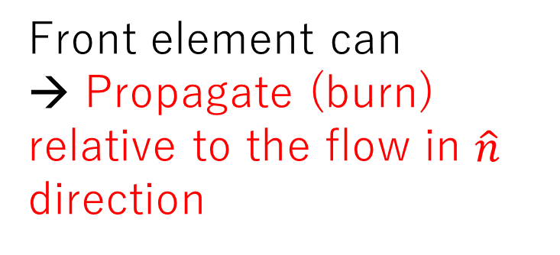
Advection Reaction Diffusion
Front element can
→ Propagate (burn) relative to the flow in $\hat{n}$ direction
u: flow velocity
v_{o}: ratio between reaction speed without a flow and flow velocity
θ: local angle of front
Mahoney, Bargteil, Kingsbury, Mitchell, and Solomon. EPL (2012)
Notes:
Reaction can move itself through the fluid (ie. Fire in oil)
… it can propagate RELATIVE to the fluid (this is what we refer to as “burning”), or it can …

Slide 7
Advection Reaction Diffusion
Front element can be
→ be rotated by the flow
u: flow velocity
v_{o}: ratio between reaction speed without a flow and flow velocity
θ: local angle of front
Mahoney, Bargteil, Kingsbury, Mitchell, and Solomon. EPL (2012)
Notes:
Rotated by the flow.
Taken together…
… it can be rotated by the fluid flow. The result is …

Slide 8
Advection Reaction Diffusion
Result is a 3D phase space through which front evolves
u: flow velocity
v_{o}: ratio between reaction speed without a flow and flow velocity
θ: local angle of front
$$\dot{x}=u_{x}+v_{0}cosθ$$
$$\dot{y}=u_{y}+v_{0}sinθ$$
$$\dot{θ}=2u_{x,x}cosθsinθ−u_{x,y}\cos^{2}θ+u_{y,x}\sin^{2}θ$$
Mahoney, Bargteil, Kingsbury, Mitchell, and Solomon. EPL (2012)
Notes:
Resulting in a 3D phase space
And 3 ODEs
… The result is a three-dimensional set of ordinary differential equations that describes by evolution of the front element in a three-dimensional (x,y,\theta) phase space.
ALMOST the same approach applies to a self-propelled tracer…

Slide 9
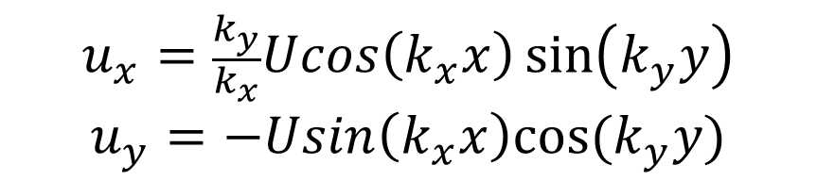
Counter-rotating vortex chain flow
$$u_{x}=\frac{k_{y}}{k_{x}}Ucos\left(k_{x}x\right)\sin\left(k_{y}y\right)$$
$$u_{y}=−Usin\left(k_{x}x\right)cos(k_{y}y)$$
(for free-slip boundary conditions)

Slide 10
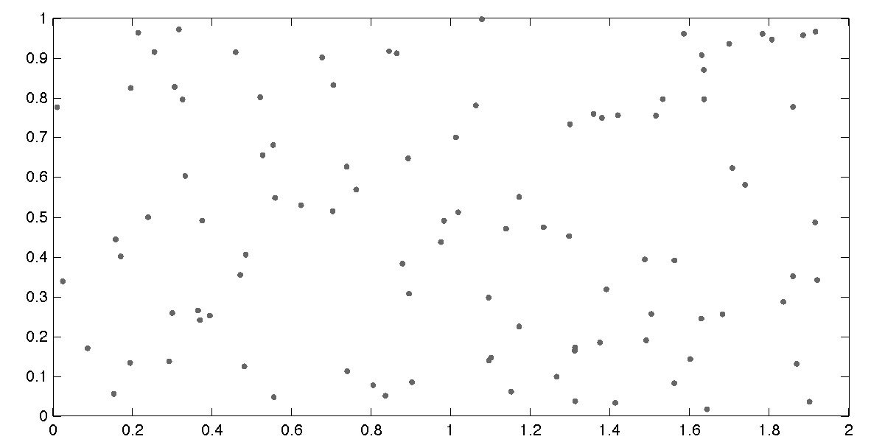
Burning invariant manifolds (BIMs) as one-way barriers to fronts
Simulations by John Mahoney & Kevin Mitchell
Notes:
Analyzing these equations predicts BIMS (Burning…) = 1 way barrier to reaction. See when it reaches it
The arrow on this tracer depicts the penetratable side
"we have verified that these BIMs act as barriers to front propagation in several different fluid flows"

Slide 11
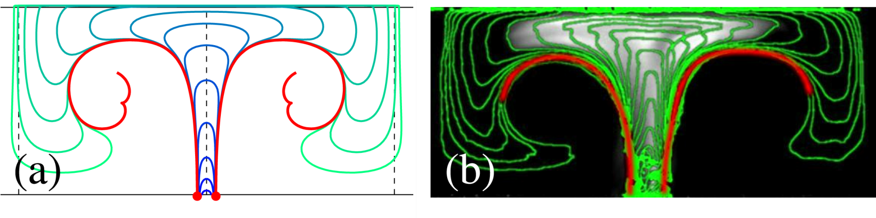
Reaction triggered at vortex corner blocked by BIMs on both sides
Theory
Experiments
Mahoney, Bargteil, Kingsbury, Mitchell, and Solomon. EPL (2012)
Notes:
Experiments done in the past confirm the existence of BIMS in various vortex flows.
See on the right, green represents reaction front…follows path traced and predicted by BIM (red)
On left, experimental images copy the theoretical prediction (right)
Now, we have done numerous experiments of fronts moving in a range of vortex flows, and what we have found in every case is that there are what we call “burning invariant manifolds” that are predicted by the theory and which show up in the experiments as barriers that block the propagating reaction fronts.
Now, almost the EXAM SAME THING happens when we look at active tracers in a fluid flow …

Slide 12
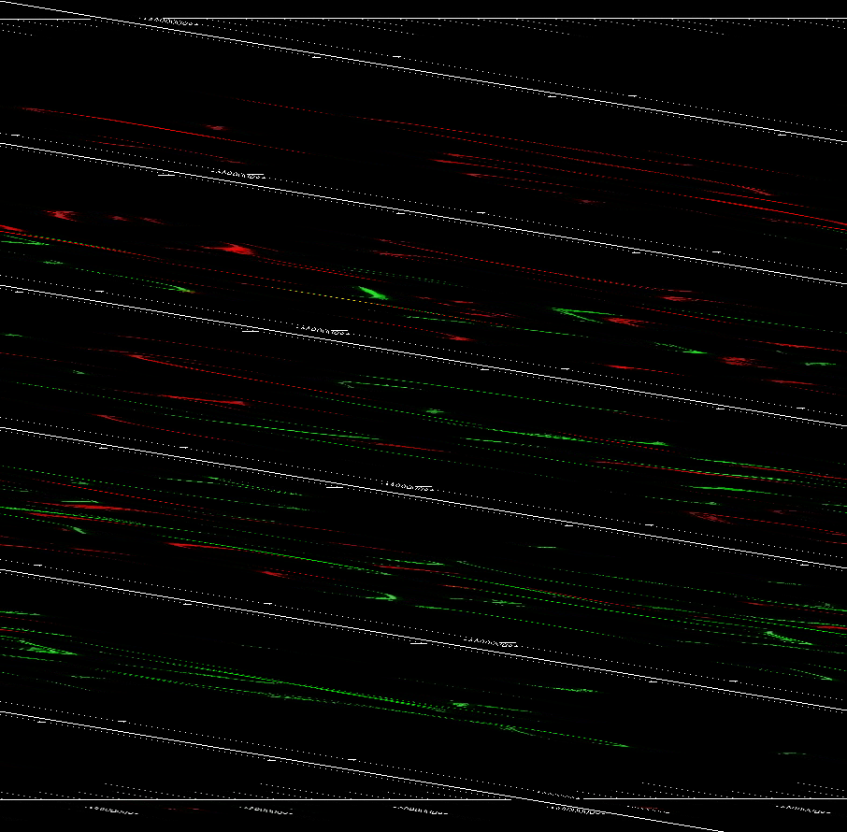
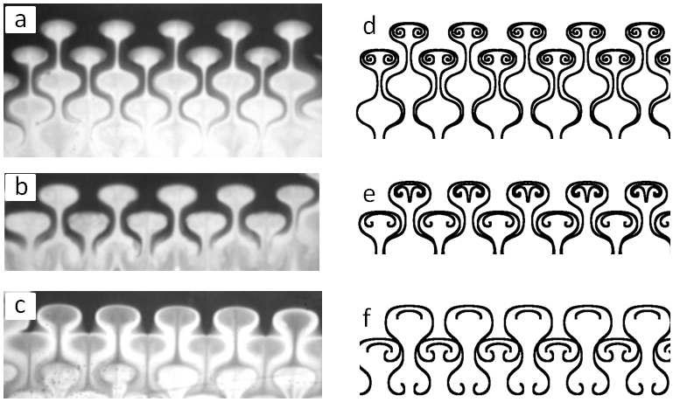
Burning invariant manifolds (BIMs) measured experimentally in a wide range of laminar flows
Pinning of reaction fronts due to BIMs in vortex flows with imposed winds.
BIMs as reaction barriers in spatially-disordered flows.
Megson, Lilienthal & Solomon,
Phys. Fluids (2015)
Mahoney, Bargteil, Kingsbury, Mitchell and Solomon, EPL (2012); Bargteil & Solomon, Chaos (2012).
Notes:
Experiments done in the past confirm the existence of BIMS in various vortex flows.
See on the right, green represents reaction front…follows path traced and predicted by BIM (red)
On left, experimental images copy the theoretical prediction (right)
Now, we have done numerous experiments of fronts moving in a range of vortex flows, and what we have found in every case is that there are what we call “burning invariant manifolds” that are predicted by the theory and which show up in the experiments as barriers that block the propagating reaction fronts.
Now, almost the EXAM SAME THING happens when we look at active tracers in a fluid flow …

Slide 13
How Do We Apply it to Swimming Microbes?

Slide 14
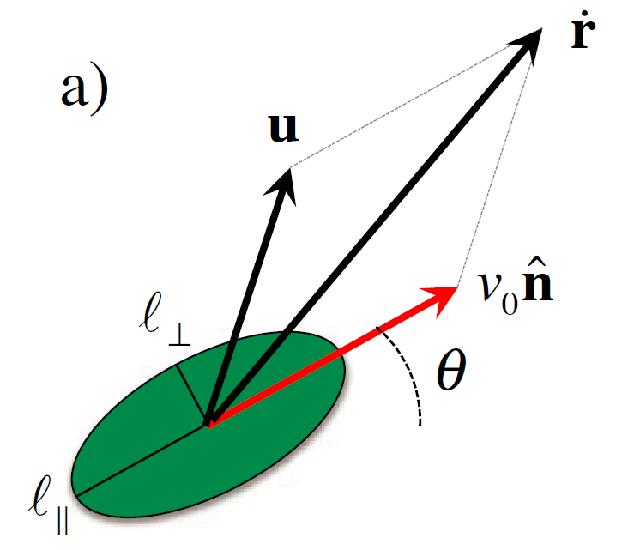
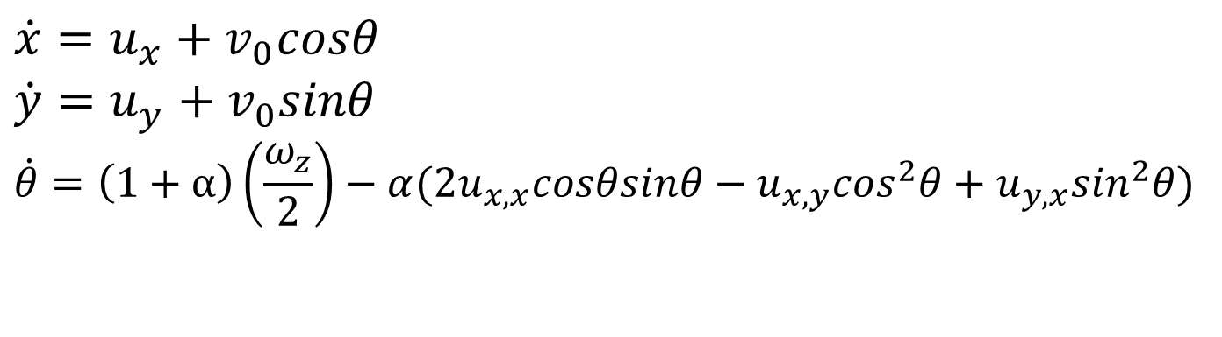
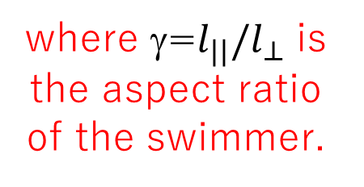
Theory for Swimmers
Same as for chemical reactions, but modified to account for shape of organism
u: flow velocity
v_{o}: ratio between swimming speed without a flow and characteristic flow speed
θ: local angle of swimmer
where γ=$l_{||}/l_{⊥}$ is the aspect ratio of the swimmer.
$$\dot{x}=u_{x}+v_{0}cosθ$$
$$\dot{y}=u_{y}+v_{0}sinθ$$
$$\dot{θ}=\left(1+α\right)\left(\frac{ω_{z}}{2}\right)−α(2u_{x,x}cosθsinθ−u_{x,y}\cos^{2}θ+u_{y,x}\sin^{2}θ)$$
Berman, Buggeln, Brantley, Mitchell, and Solomon, Phys. Rev. Fluids 6 L012501 (2021)
Notes:
EQ should look familiar
The same theory can be applied to a microbe, or tracer, in a flow!
Only change is accounting for shape of the organism (point)
If we now consider a swimming microbe in a fluid flow, again we need three variables to denote it’s location and angle [point to x, y and \theta]. And again, there are three things that can happen to this microbe, just like a reaction front element. The microbe can (1) be carried by the flow; (2) can SWIM relative to the fluid flow [I usually act this out by waving my hand]; and (3) it can be rotated by the flow. The only difference between the theory for active tracers versus propagating fronts is that the aspect ratio of the swimmer has to be considered in the third equation.
So, one of the key ideas in this active mixing work is that …

Slide 15
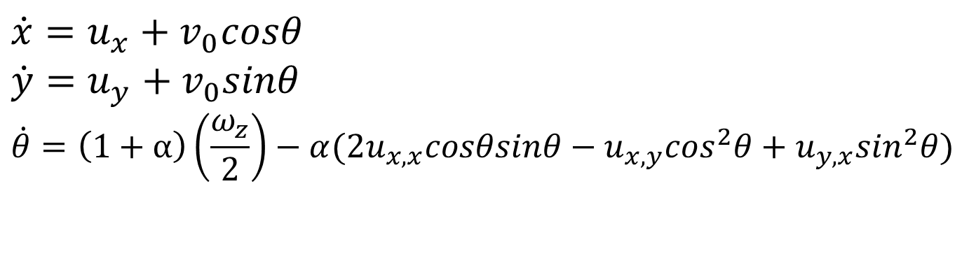
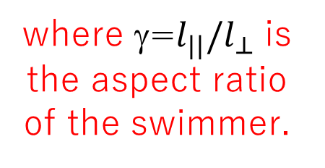
Theory for Swimmers
Swimmer can
→ be advected by the flow
u: flow velocity
v_{o}: ratio between swimming speed without a flow and characteristic flow speed
θ: local angle of swimmer
u
$$\dot{x}=u_{x}+v_{0}cosθ$$
$$\dot{y}=u_{y}+v_{0}sinθ$$
$$\dot{θ}=\left(1+α\right)\left(\frac{ω_{z}}{2}\right)−α(2u_{x,x}cosθsinθ−u_{x,y}\cos^{2}θ+u_{y,x}\sin^{2}θ)$$
where γ=$l_{||}/l_{⊥}$ is the aspect ratio of the swimmer.
Berman, Buggeln, Brantley, Mitchell, and Solomon, Phys. Rev. Fluids 6 L012501 (2021)
Notes:
Once again, the microbe can be carried by the current..
If we now consider a swimming microbe in a fluid flow, again we need three variables to denote it’s location and angle [point to x, y and \theta]. And again, there are three things that can happen to this microbe, just like a reaction front element. The microbe can (1) be carried by the flow; (2) can SWIM relative to the fluid flow [I usually act this out by waving my hand]; and (3) it can be rotated by the flow. The only difference between the theory for active tracers versus propagating fronts is that the aspect ratio of the swimmer has to be considered in the third equation.
So, one of the key ideas in this active mixing work is that …

Slide 16
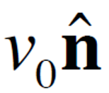
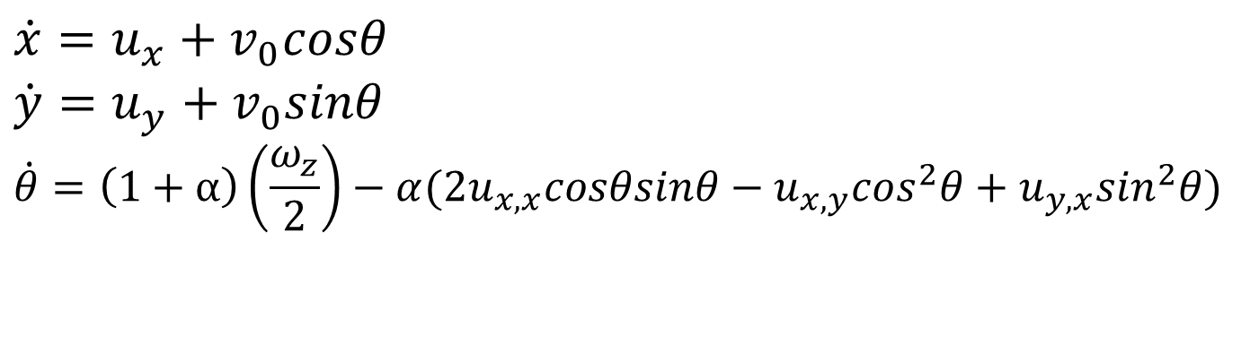
Theory for Swimmers
Swimmer can
→ swim relative to the fluid
u: flow velocity
v_{o}: ratio between swimming speed without a flow and characteristic flow speed
θ : local angle of swimmer
$$\dot{x}=u_{x}+v_{0}cosθ$$
$$\dot{y}=u_{y}+v_{0}sinθ$$
$$\dot{θ}=\left(1+α\right)\left(\frac{ω_{z}}{2}\right)−α(2u_{x,x}cosθsinθ−u_{x,y}\cos^{2}θ+u_{y,x}\sin^{2}θ)$$
Berman, Buggeln, Brantley, Mitchell, and Solomon, Phys. Rev. Fluids 6 L012501 (2021)
Notes:
Swim under its own power…
If we now consider a swimming microbe in a fluid flow, again we need three variables to denote it’s location and angle [point to x, y and \theta]. And again, there are three things that can happen to this microbe, just like a reaction front element. The microbe can (1) be carried by the flow; (2) can SWIM relative to the fluid flow [I usually act this out by waving my hand]; and (3) it can be rotated by the flow. The only difference between the theory for active tracers versus propagating fronts is that the aspect ratio of the swimmer has to be considered in the third equation.
So, one of the key ideas in this active mixing work is that …

Slide 17
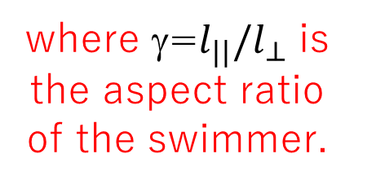
Theory for Swimmers
Swimmer can
→ be rotated by the flow
u: flow velocity
v_{o}: ratio between swimming speed without a flow and characteristic flow speed
θ: local angle of swimmer
where γ=$l_{||}/l_{⊥}$ is the aspect ratio of the swimmer.
$$\dot{x}=u_{x}+v_{0}cosθ$$
$$\dot{y}=u_{y}+v_{0}sinθ$$
$$\dot{θ}=\left(1+α\right)\left(\frac{ω_{z}}{2}\right)−α(2u_{x,x}cosθsinθ−u_{x,y}\cos^{2}θ+u_{y,x}\sin^{2}θ)$$
Berman, Buggeln, Brantley, Mitchell, and Solomon, Phys. Rev. Fluids 6 L012501 (2021)
Notes:
Or be rotated by the flow!
And take into account the swimming direction
Explain alpa (positive negative)
Special case → \alpha = -1 = reaction front
If we now consider a swimming microbe in a fluid flow, again we need three variables to denote it’s location and angle [point to x, y and \theta]. And again, there are three things that can happen to this microbe, just like a reaction front element. The microbe can (1) be carried by the flow; (2) can SWIM relative to the fluid flow [I usually act this out by waving my hand]; and (3) it can be rotated by the flow. The only difference between the theory for active tracers versus propagating fronts is that the aspect ratio of the swimmer has to be considered in the third equation.
So, one of the key ideas in this active mixing work is that …

Slide 18
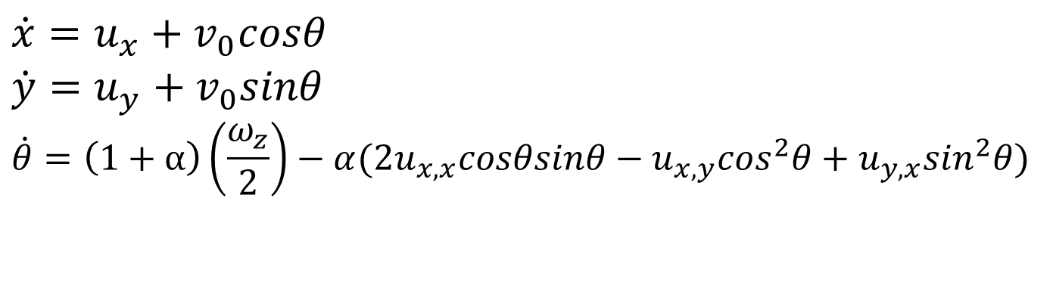

Theory for Swimmers
Same as for chemical reactions, but modified to account for shape of organism
u: flow velocity
v_{o}: ratio between swimming speed without a flow and characteristic flow speed
θ: local angle of swimmer
$$\dot{x}=u_{x}+v_{0}cosθ$$
$$\dot{y}=u_{y}+v_{0}sinθ$$
$$\dot{θ}=\left(1+α\right)\left(\frac{ω_{z}}{2}\right)−α(2u_{x,x}cosθsinθ−u_{x,y}\cos^{2}θ+u_{y,x}\sin^{2}θ)$$
where γ=$l_{||}/l_{⊥}$ is the aspect ratio of the swimmer.
Berman, Buggeln, Brantley, Mitchell, and Solomon, Phys. Rev. Fluids 6 L012501 (2021)
Notes:
Again, resulting in 3D phase space and 3 ODEs. This application of the theory has been tested previously as well…
If we now consider a swimming microbe in a fluid flow, again we need three variables to denote it’s location and angle [point to x, y and \theta]. And again, there are three things that can happen to this microbe, just like a reaction front element. The microbe can (1) be carried by the flow; (2) can SWIM relative to the fluid flow [I usually act this out by waving my hand]; and (3) it can be rotated by the flow. The only difference between the theory for active tracers versus propagating fronts is that the aspect ratio of the swimmer has to be considered in the third equation.
So, one of the key ideas in this active mixing work is that …

Slide 19
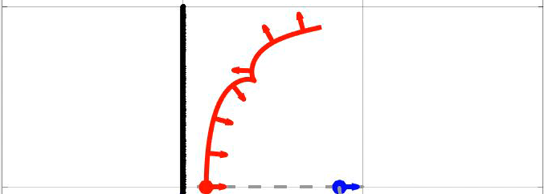
Swimming invariant manifolds (SwIMs) as one-way barriers to fronts
Simulation by Simon Berman
Notes:
Looking for barriers such as these. Remember they are determined by the swimming velocity. That reveals one of the largest challenges of this project,
Notice how the bacteria are first blocked by the red SWIM, but then can pass through the other side

Slide 20
Magnetohydrodynamic Forcing
1.0 mm
Acrylic channel with width 1.0 mm and depth 1.0 mm
Notes:
[Mostly likely, “But there isn’t time for a detailed discussion of the results (which are all very preliminary now anyway). [Just flip through the slides quickly and jump to the summary.]

Slide 21
Magnetohydrodynamic Forcing
S
N
S
N
S
N
S
Strips of alternating magnets below the channel
Notes:
[Mostly likely, “But there isn’t time for a detailed discussion of the results (which are all very preliminary now anyway). [Just flip through the slides quickly and jump to the summary.]

Slide 22
Magnetohydrodynamic Forcing
I
I
S
N
S
N
S
N
S
Electrical current
Notes:
[Mostly likely, “But there isn’t time for a detailed discussion of the results (which are all very preliminary now anyway). [Just flip through the slides quickly and jump to the summary.]

Slide 23
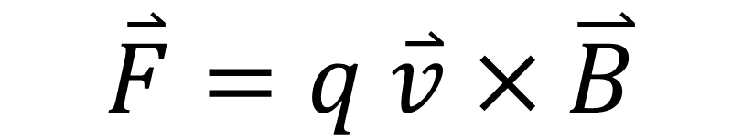
Magnetohydrodynamic Forcing
I
I
S
N
S
N
S
N
S
Magnetic forcing in fluid
$$\overset{⃑}{F}=q \overset{⃑}{v}×\overset{⃑}{B}$$
Notes:
[Mostly likely, “But there isn’t time for a detailed discussion of the results (which are all very preliminary now anyway). [Just flip through the slides quickly and jump to the summary.]

Slide 24
Magnetohydrodynamic Forcing
Vortex chain flow
Notes:
[Mostly likely, “But there isn’t time for a detailed discussion of the results (which are all very preliminary now anyway). [Just flip through the slides quickly and jump to the summary.]

Slide 25
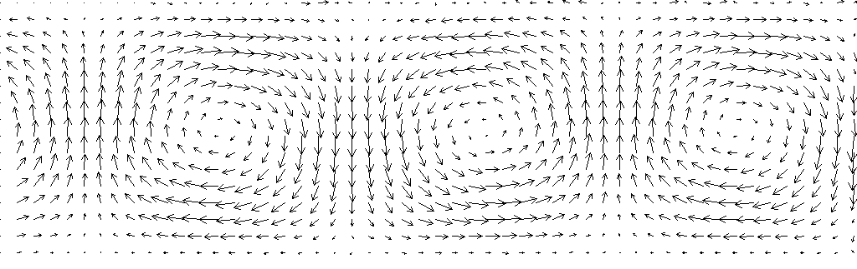
Resulting velocity field
Notes:
This is the velocity field. Relatively no major outliers from the calculation.

Slide 26
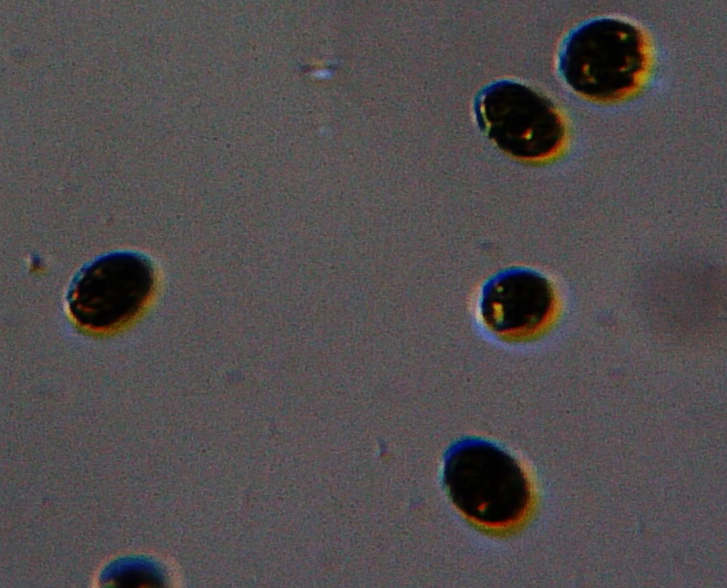
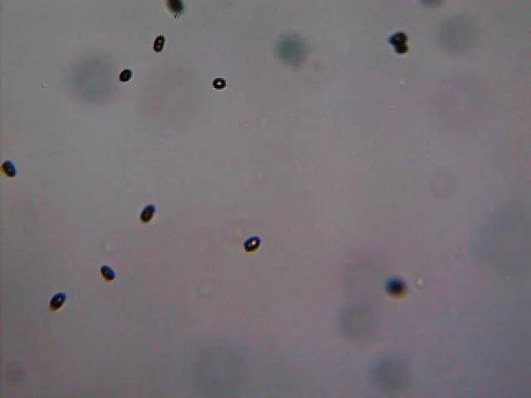
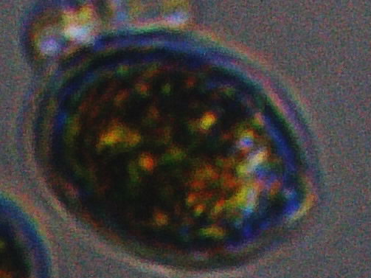
Swimming microbes: tetraselmis
≈ 0.3 - 0.4
(typical swimming speeds ~ 100 – 150 μm/s)

Slide 27
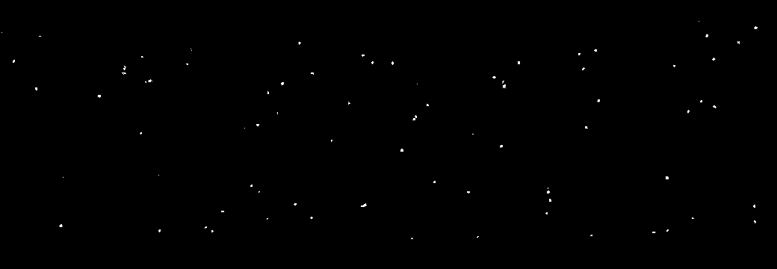
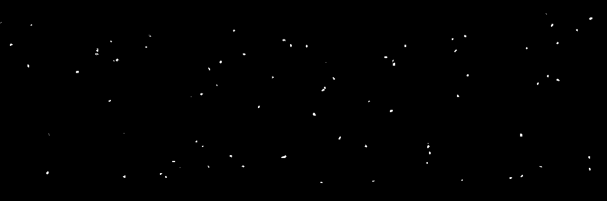
Tetraselmis swimming in channel, no imposed flow
Notes:
Switch these to no flow movies in the cell.

Slide 28
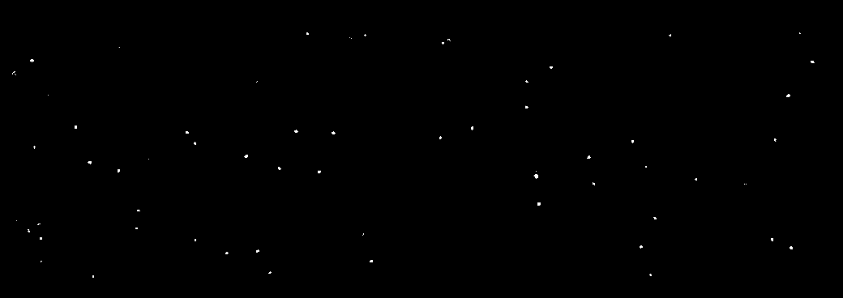
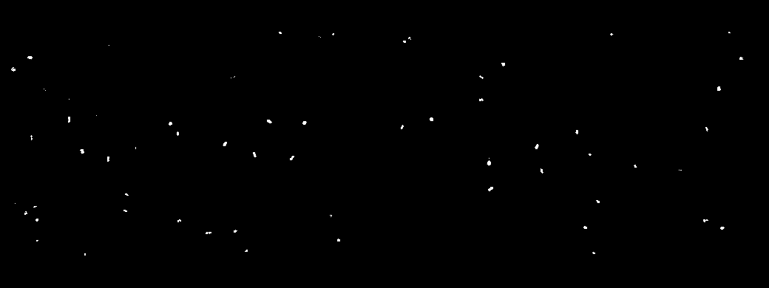
Tetraselmis swimming in vortex flow, U = 370 μm/s

Slide 29
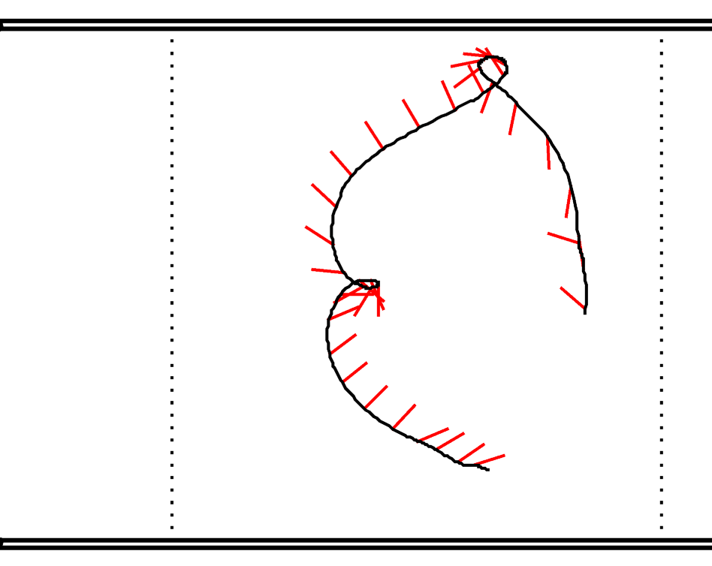
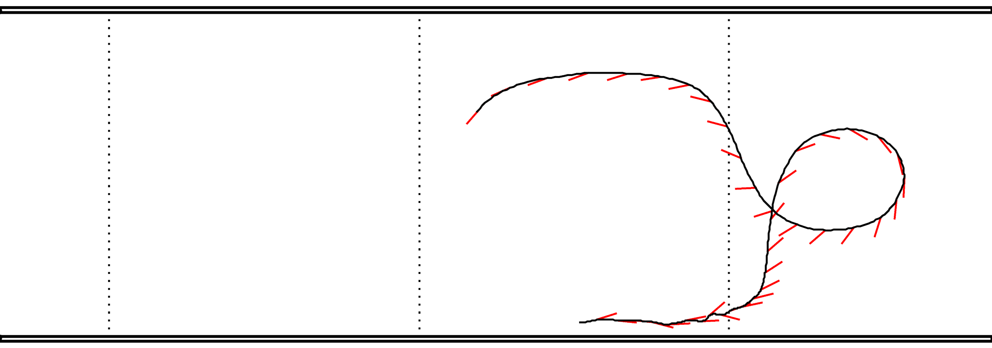
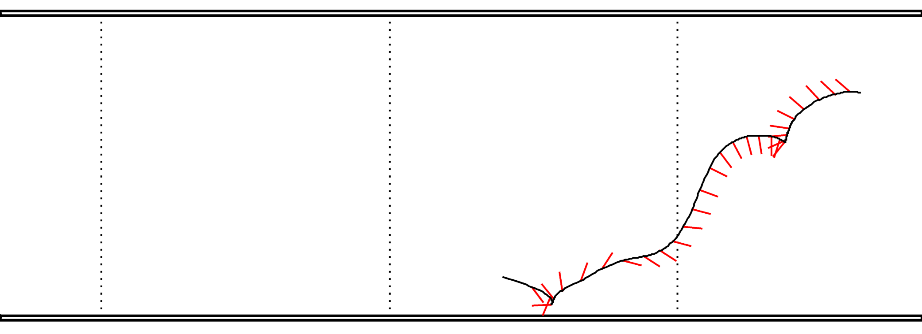
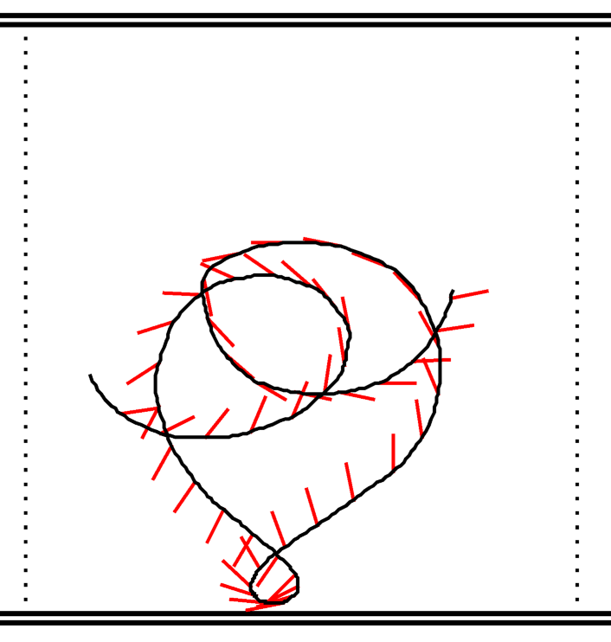
v₀ = V_{s}/U = 0.5
The red segments show the swimming orientation, with the tail at the black curve
Notes:
Point out the prevalence of loops. Large loops (upper right), smaller loops (lower left and upper left), very narrow loops (upper left), and cusps, which are like vanishing loops (lower right). In all cases, there is a flip of PI radians going around the loop. (Note: I think that the loops disappear for alpha = -1 and they become cusps).
These are sf_00275 from 102621f (upper left), sf_06607 from 102621f (upper right), sf_01814 from 102621f (bottom right), sh_00523 from 110121h (lower left)

Slide 30
Common features
v₀ = V_{s}/U = 0.5
Loops, typically accompanied by a flip of 180º in swimming orientation.
The red segments show the swimming orientation, with the tail at the black curve
Notes:
Point out the prevalence of loops. Large loops (upper right), smaller loops (lower left and upper left), very narrow loops (upper left), and cusps, which are like vanishing loops (lower right). In all cases, there is a flip of PI radians going around the loop. (Note: I think that the loops disappear for alpha = -1 and they become cusps).
These are sf_00275 from 102621f (upper left), sf_06607 from 102621f (upper right), sf_01814 from 102621f (bottom right), sh_00523 from 110121h (lower left)

Slide 31
Common features
v₀ = V_{s}/U = 0.5
Cusps, also accompanied by a flip in orientation by 180º.
The red segments show the swimming orientation, with the tail at the black curve
Notes:
Point out the prevalence of loops. Large loops (upper right), smaller loops (lower left and upper left), very narrow loops (upper left), and cusps, which are like vanishing loops (lower right). In all cases, there is a flip of PI radians going around the loop. (Note: I think that the loops disappear for alpha = -1 and they become cusps).
These are sf_00275 from 102621f (upper left), sf_06607 from 102621f (upper right), sf_01814 from 102621f (bottom right), sh_00523 from 110121h (lower left)

Slide 32
Cusps are a common feature between reaction fronts and swimming microbes – associated with flip in direction.
Simulations by John Mahoney & Kevin Mitchell
Notes:
Analyzing these equations predicts BIMS (Burning…) = 1 way barrier to reaction. See when it reaches it
The arrow on this tracer depicts the penetratable side
"we have verified that these BIMs act as barriers to front propagation in several different fluid flows"

Slide 33
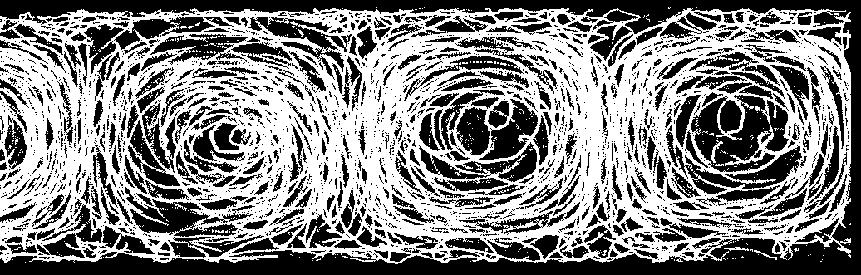
Can combine boundary-crossing trajectories from all three separatrices …

Slide 34
Tracers can cross vortex boundary going to the right …

Slide 35
… or tracers can cross vortex boundary going to the left

Slide 36
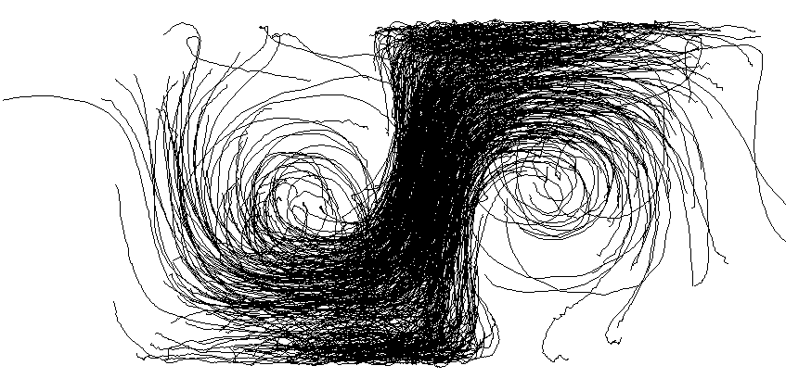
Experimentally, there are curves (SwIMs?) that block swimmers going to the right …
v₀ = V_{s}/U = 0.5

Slide 37
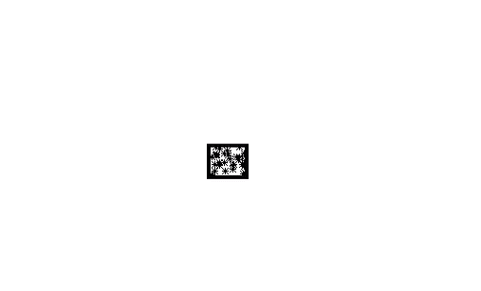
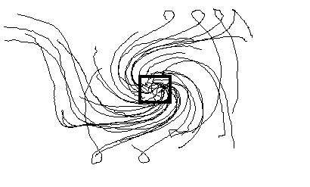
… but allow swimmers to cross freely in the other direction.
v₀ = V_{s}/U = 0.5

Slide 38
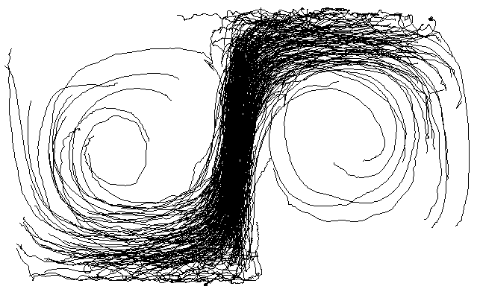
v₀ = V_{s}/U = 0.3

Slide 39
v₀ = V_{s}/U = 0.3
Swimming fixed point (blocking outward swimming)

Slide 40
v₀ = V_{s}/U = 0.3
Unstable swimming invariant manifold (blocking outward swimming)

Slide 41
Stable swimming invariant manifold of top fixed point
v₀ = V_{s}/U = 0.3

Slide 42
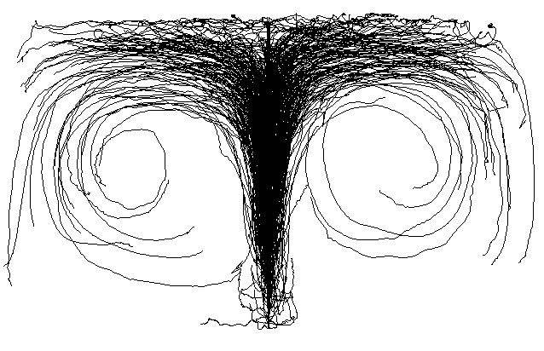
v₀ = V_{s}/U = 0.3
Notes:
Different Vo/U. Comparison with fronts.
Add stuff from Simon/Kevin’s paper. Chaotic and ordered behavior. Tori. Trapping.

Slide 43
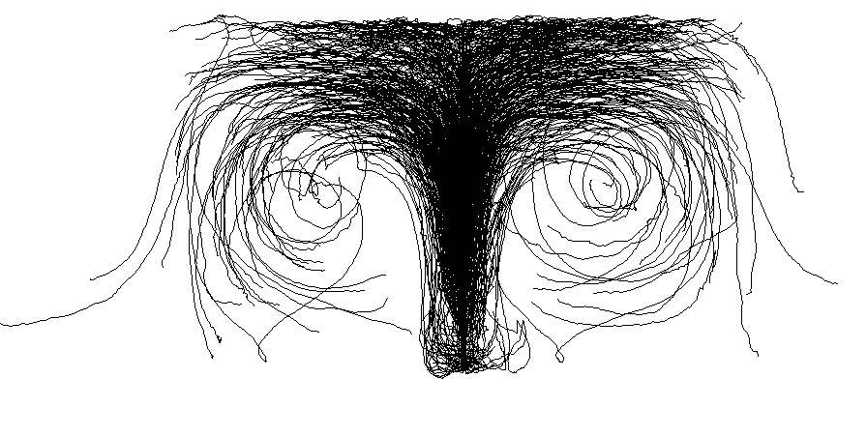
v₀ = V_{s}/U = 0.4

Slide 44
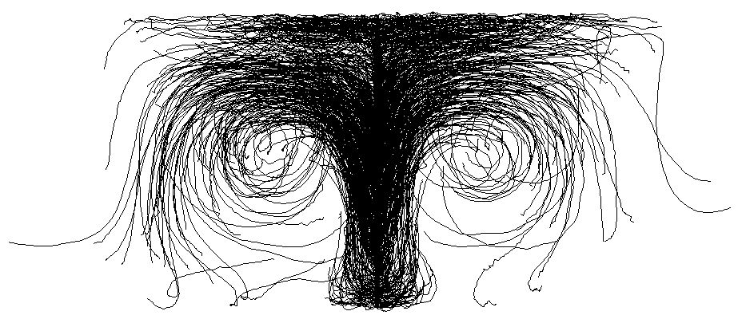
v₀ = V_{s}/U = 0.5

Slide 45
Similar one-way barriers for both swimming microbes and propagating fronts in a vortex-chain flow
Swimming microbes
Reaction fronts

Slide 46
Key takeaway: critical importance of invariant manifolds in at least two, very different active mixing systems.
Swimming Invariant Manifolds have also be measured experimentally for hyperbolic flows.
See Berman, Buggeln, Brantley, Mitchell, and Solomon, Phys. Rev. Fluids 6 L012501 (2021).
Notes:
Notes: works remarkably well, even though bacteria swim with different speeds and aren’t swimming perfectly straight – lots of rocking back ‘n forth, varies from one to another. What about for bacteria that have NOT been mutated to swim

Slide 47
Chaotic and ordered trajectories of active tracers in vortex arrays
Trapped trajectory
“Escaping” trajectory
Berman & Mitchell, Chaos 30, 063121 (2020)
Notes:
Talk with Simon – has been doing simulations of chaotic trajectories in this flow.

Slide 48


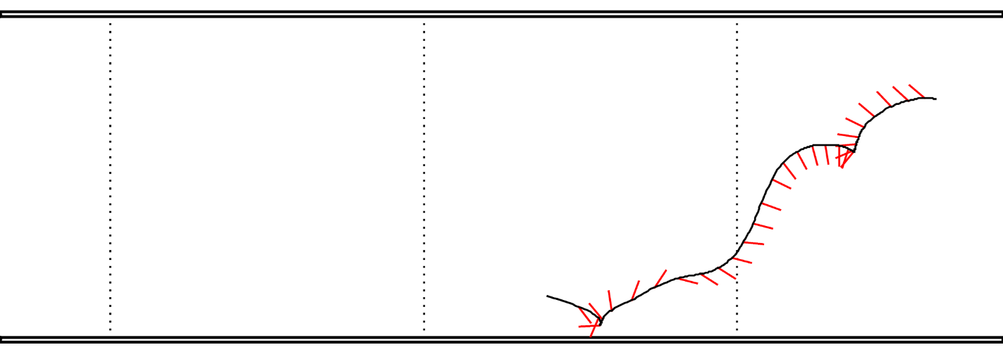

Chaotic and ordered trajectories of active tracers in vortex arrays
Part of a chaotic trajectory?
v₀ = V_{s}/U = 0.5
The red segments show the swimming orientation, with the tail at the black curve
Notes:
Talk with Simon – has been doing simulations of chaotic trajectories in this flow.

Slide 49
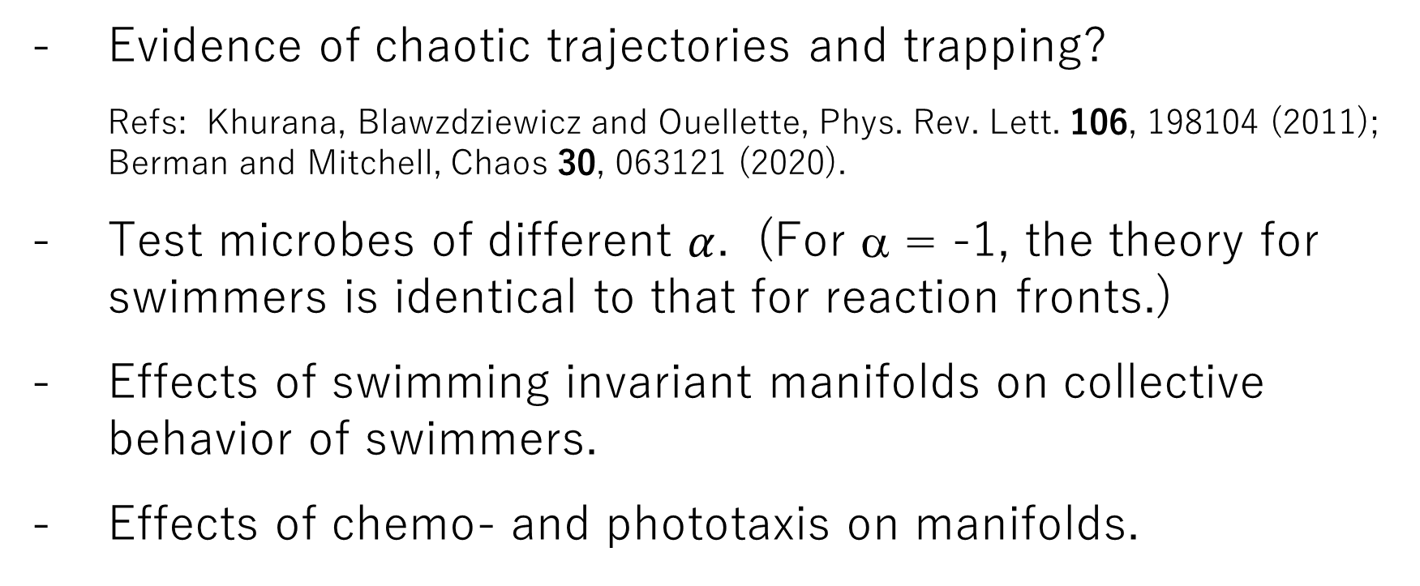
Continuing Work
Evidence of chaotic trajectories and trapping?
Refs: Khurana, Blawzdziewicz and Ouellette, Phys. Rev. Lett. 106, 198104 (2011); Berman and Mitchell, Chaos 30, 063121 (2020).
Test microbes of different $α$. (For α = -1, the theory for swimmers is identical to that for reaction fronts.)
Effects of swimming invariant manifolds on collective behavior of swimmers.
Effects of chemo- and phototaxis on manifolds.
Notes:
More data is always helpful
Time dependent flows maybe = chaotic traj’s….
Different alpha = different manifolds/barrier shapes and patterns
Again, completing velocity subtraction opens up the doors for complete analysis of these systems.

